Slide 1

Big Data analytics Project Network Congestion Analysis
Presented By:
Rohit Gupta(181500590)
B.Tech CSE Section-3C
Project Mentor: Mr. Ashutosh Shankhdhar

Slide 2
Problem Statement
Almost everyone is connected through telecommunication. Which creates heavy traffic and that traffic on telecommunication network causes congestion.
Some problems due to congestion are→ a) Packet Loss , b) High ping, c) performance degradation.
To control congestion, analyse the traffic in the network based on past data and predict the traffic and bandwidth cost required to avoid congestion.

Slide 3
Dataset
The dataset consists of 2 columns
1: Date
2: Traffic
It consists traffic on around 120 different dates
Data resource: https://www.kaggle.com/crawford/computer-network-traffic

Slide 4
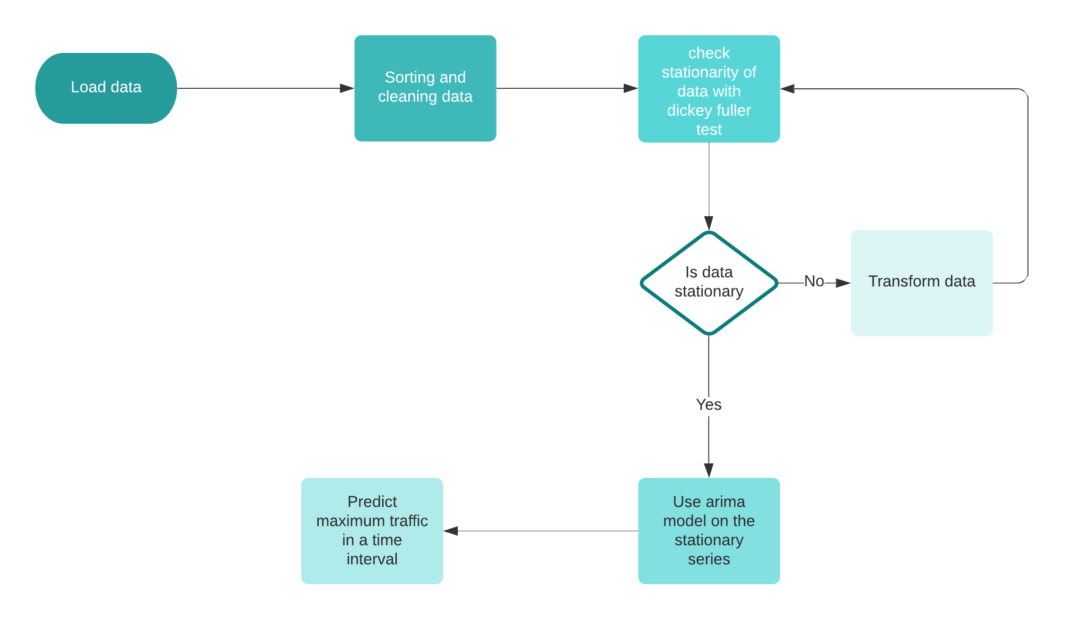
Approach

Slide 5
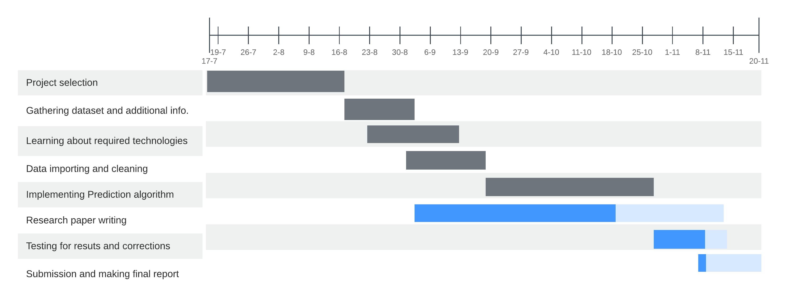
Project planning

Slide 6
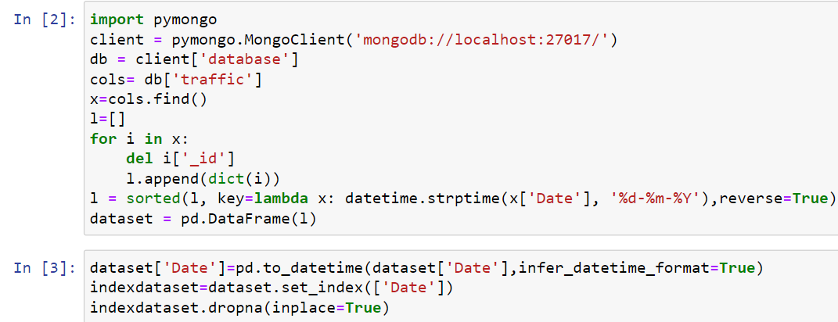
Implementation
Importing and sorting Data

Slide 7
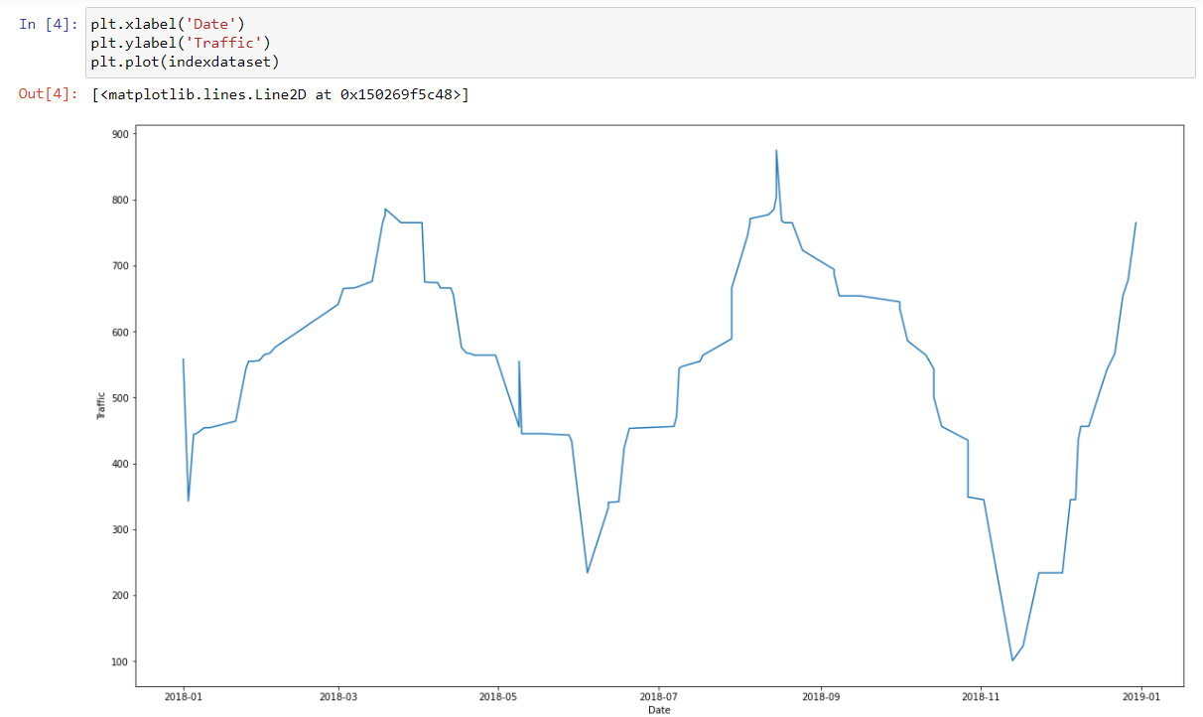
Exploratory analysis
Network Traffic in 2018

Slide 8
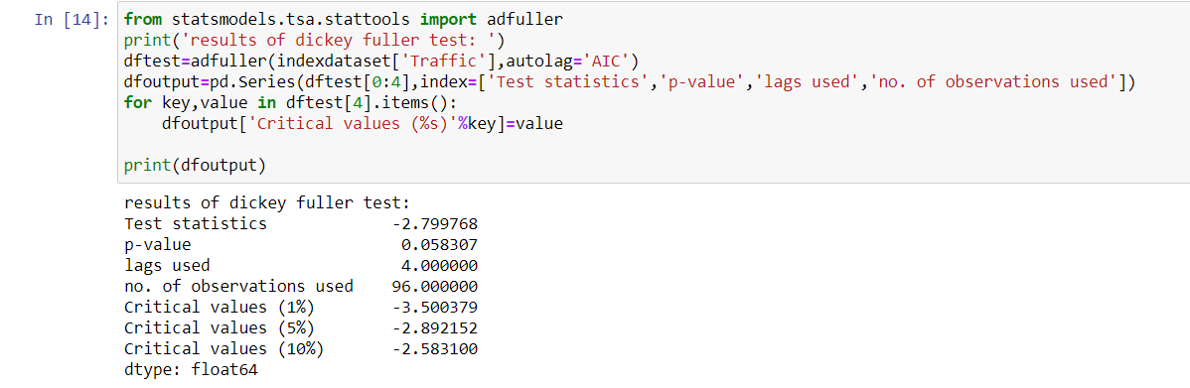
Dickey-fuller test
To check if the data is stationary or not

Slide 9
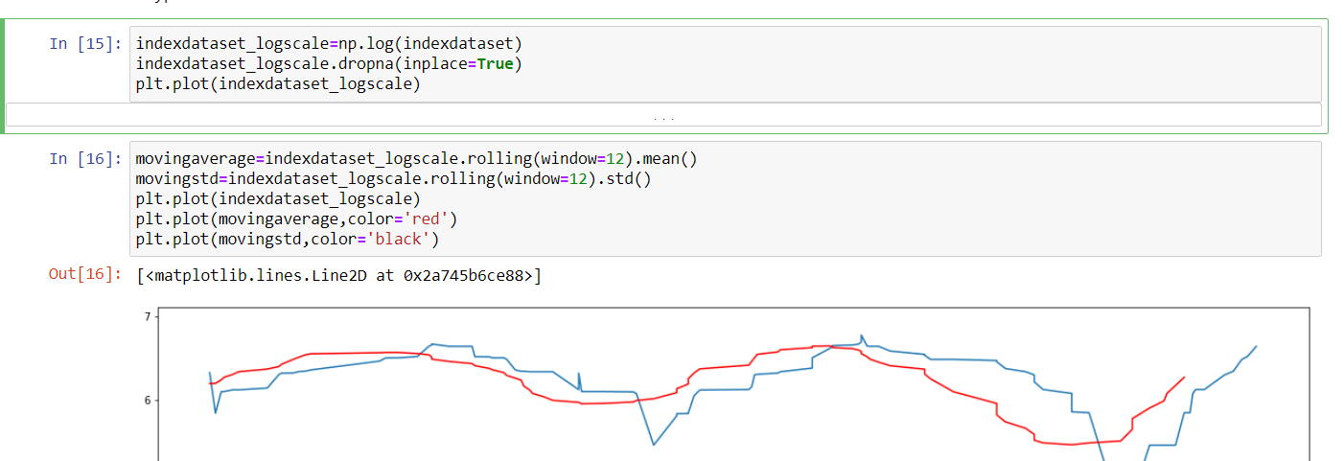
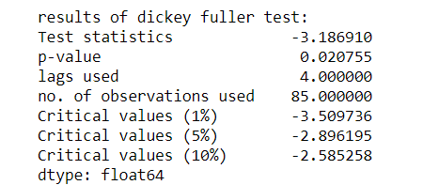
Transforming to make series stationary

Slide 10
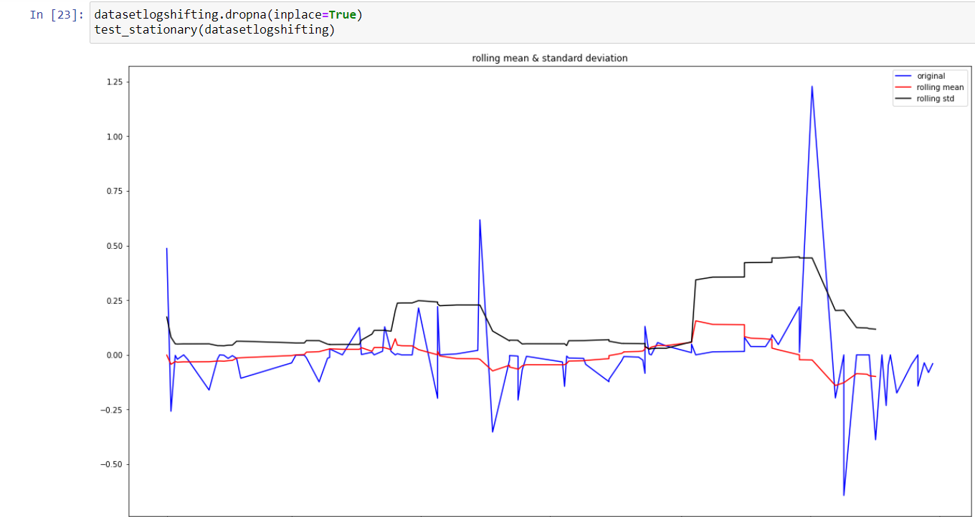
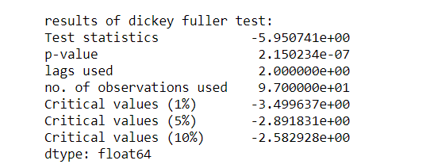
Final stationary series

Slide 11
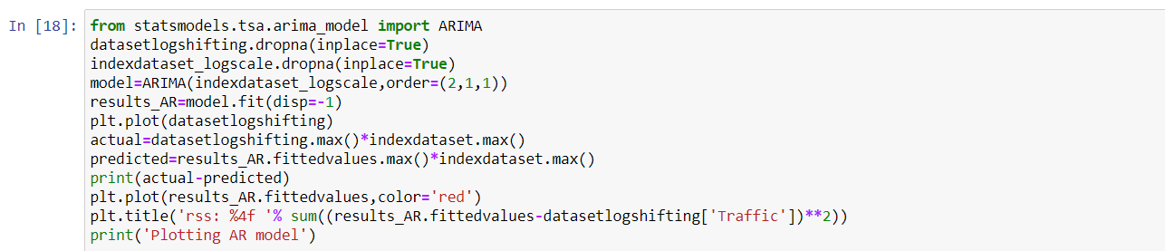
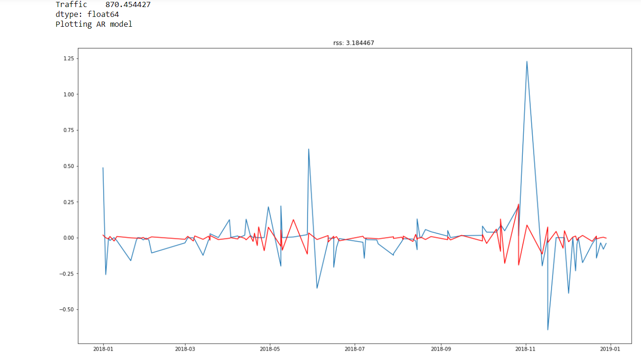

Slide 12
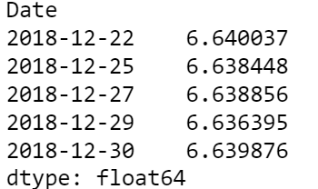
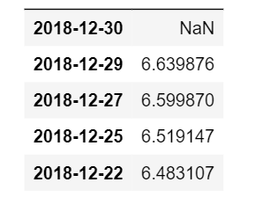
Predicted result This is the prediction result but by model and dataset log transformed
Prediction By Model
Original data

Slide 13
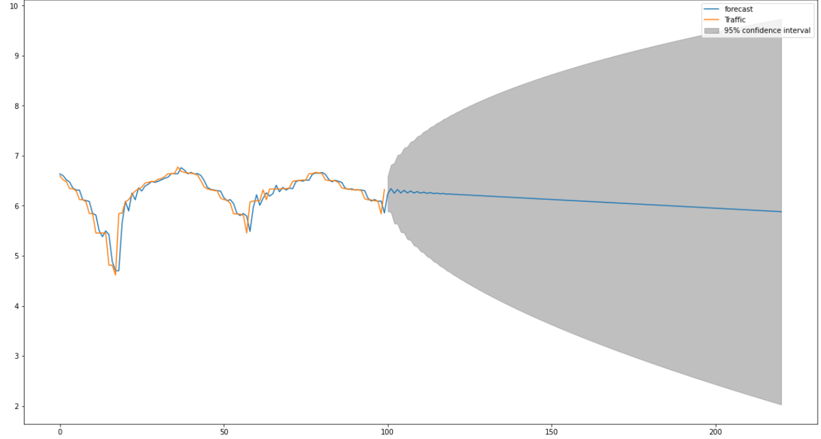
Prediction Result Plot

Slide 14
Thank You

